Slide 1
Statistical data analysis and research methods BMI504 Course 22903 – Spring 2017
Class 3 – Feb 15, 2017
Qualitative Research Methods:
theory and data collection methods
Werner CEUSTERS

Slide 2
C3. Qualitative research methods: theory and data collection methods
Pre-class reading:
Kirsti Malterud. Theory and interpretation in qualitative studies from general practice: Why and how?
Scandinavian Journal of Public Health, 2016; 44: 120–129
http://journals.sagepub.com/doi/pdf/10.1177/1403494815621181
Class structure:
lecture on common qualitative data collection methods (Document Review, Observation, Interview (face-to-face), Focus Group Discussion, Ethnography,…),
discussion of the pre-reading paper on the basis of what was taught in the lecture.
Time permitting: discussion of C2-application test in light of a)
Post-class assignment: open book test with multiple choice questions and open-ended motivation based on literature. Deadline: Feb 22, noon.

Slide 3
C3 Assessment
Participation in discussion
50% on lecture part
50% on discussion of pre-lecture reading
2) Evaluation of post-class assessment:
a) Delivered in time
b) content

Slide 4
NEXT WEEK C4. Introduction to data analysis of quantitative and qualitative variables
Pre-class readings:
Savitri Abeyasekera. Quantitative analysis approaches to qualitative data: why, when and how?
John PA Ioannidis. Why Most Published Research Findings Are False.
Class structure: interactive lecture.
Post-class assignment: none.
Assessment:
pre-lecture test on readings,
participation in interactive lecture.

Slide 5
Qualitative Research Methods
A bit of theory

Slide 6
Qualitative Research Foundations
Although reality is objectively the way it is, it is not observed or experienced in one single agreed upon way.
Interpretations are socially constructed by individuals in their interaction with their local reality.
Therefore, there are multiple interpretations of reality that are in flux and that change over time.
Qualitative researchers are interested in understanding what those interpretations are at a particular point in time and in a particular context.
The purpose is NOT to predict.

Slide 7
Different types of study design
Ethnography:
Portrait of people-study of the story and culture of a group usually to develop cultural awareness and sensitivity;
Phenomenology:
Study of individual’s lived experiences of events-e.g. the experience of AIDS care;
Grounded Theory:
Going beyond adding to the existing body of knowledge-developing a new theory about a phenomenon-theory grounded on data;
Participatory action research:
Individuals & groups researching their own personal beings, socio-cultural settings and experiences;
Case study:
In-depth investigation of a single or small number of units at a point (over a period) in time.
Joan LaFrance. Fundamentals of Qualitative Research. AIHEC NARCH Meeting DinѐCollege. June 25, 2015

Slide 8
Field notes are crucial
Field notes:
are transcribed notes or the written account derived from data collected during observations.
Generally consist of two parts:
descriptive in which the observer attempts to capture a word-picture of the setting, actions and conversations; and
reflective in which the observer records thoughts, ideas, questions and concerns based on the observations and interviews.
Should be written as soon as possible after the observation and/or interviews.
Joan LaFrance. Fundamentals of Qualitative Research. AIHEC NARCH Meeting DinѐCollege. June 25, 2015

Slide 9
Data Reduction becomes a need
Qualitative studies produce a wealth of data but not all of it is meaningful. Identify and focus in on what is meaningful.
Transform the data into a simplified format that can be understood in the context of the research questions
When trying to discern what is meaningful data always refer back to the research questions and use them as a framework.
Hone in on specific patterns and themes of interest while not focusing on other aspects of the data.
Joan LaFrance. Fundamentals of Qualitative Research. AIHEC NARCH Meeting DinѐCollege. June 25, 2015

Slide 10
Qualitative Research Methods
Data Collection Methods

Slide 11
Types of Data Collection in QRM
Survey
Interviews
Focus groups
Observation
(Data) extraction
Secondary data sources
Ethnography
MC. Harrell & MA. Bradley. Data Collection Methods: Semi-Structured Interviews and Focus Groups. RAND Corporation 2009. http://www.rand.org/pubs/technical_reports/TR718.html

Slide 12
Types of Data Collection in QRM
Survey
Interviews
Focus groups
Observation
(Data) extraction
Secondary data sources
Ethnography
Which one happens always in QR?
MC. Harrell & MA. Bradley. Data Collection Methods: Semi-Structured Interviews and Focus Groups. RAND Corporation 2009. http://www.rand.org/pubs/technical_reports/TR718.html

Slide 13
Types of Data Collection in QRM
Survey = document
Interviews produce document
Focus groups produce document
Observations produce document
(Data) extraction
Secondary data sources = document
Ethnography produce document
MC. Harrell & MA. Bradley. Data Collection Methods: Semi-Structured Interviews and Focus Groups. RAND Corporation 2009. http://www.rand.org/pubs/technical_reports/TR718.html

Slide 14
Types of Data Collection in QRM
Survey
Interviews
Focus groups
Observation
(Data) extraction
Secondary data sources
Ethnography
fixed sets of questions (questionnaire),
delivery methods:
‘paper and pencil’
Web form,
by an interviewer who follows a strict script.
MC. Harrell & MA. Bradley. Data Collection Methods: Semi-Structured Interviews and Focus Groups. RAND Corporation 2009. http://www.rand.org/pubs/technical_reports/TR718.html

Slide 15
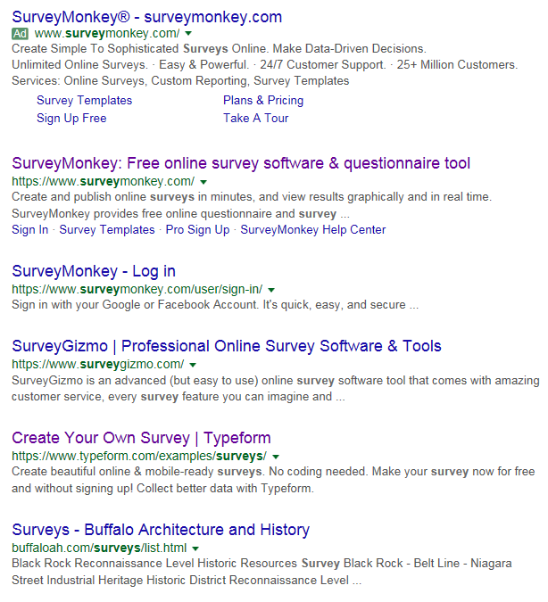
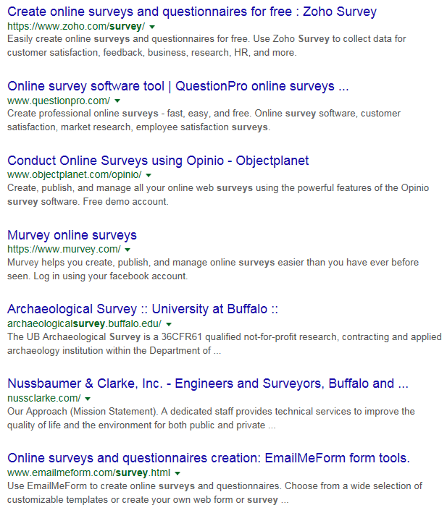
Web surveys, anything more popular?

Slide 16
Pros and Cons of Surveys
Advantages:
· Good for gathering descriptive data,
· Can cover a wide range of topics,
· Are relatively inexpensive to use,
· Can be analyzed using a variety of existing software.
Disadvantages:
· Self-report may lead to biased reporting,
· Data may provide a general picture but lack depth,
· May not provide adequate information on context.
NSF. The 2002 User Friendly Handbook for Project Evaluation. Section III - An Overview of Quantitative and Qualitative Data Collection Methods. https://www.nsf.gov/pubs/2002/nsf02057/nsf02057_4.pdf

Slide 17
C5. Surveys and questionnaire construction Use of EPI-Info (CDC)

Slide 18
Types of Data Collection in QRM
Survey
Interviews
Focus groups
Observation
(Data) extraction
Secondary data sources
Ethnography
One-to-one discussions;
Focused on specific topics;
Dialogue evolves based on experience and knowledge of interviewee.
MC. Harrell & MA. Bradley. Data Collection Methods: Semi-Structured Interviews and Focus Groups. RAND Corporation 2009. http://www.rand.org/pubs/technical_reports/TR718.html

Slide 19
Some interview types
By purpose:
Opinions, perceptions, attitudes, …, or
Background knowledge, facts, experiences.
By level of control:
Unstructured;
Semi-structured:
Interviewer has various facets of answers to questions in mind, but wants also to determine whether interviewee categorizes similarly;
Structured:
Specific questions with room for unanticipated perspectives.
MC. Harrell & MA. Bradley. Data Collection Methods: Semi-Structured Interviews and Focus Groups. RAND Corporation 2009. http://www.rand.org/pubs/technical_reports/TR718.html

Slide 20
Some types of questions
Hypothetical:
If you get the chance to be an HIV scientist, do you think you can discover a vaccine for HIV?
Provocative:
I have heard people saying most evaluations are subjective-what do you think?
Ideal:
In your opinion, what would be the best solution for eliminating gender-based violence?
Interpretative:
What do you mean by good?
Provocative:
I have heard people saying most evaluations are subjective-what do you think?
Joan LaFrance. Fundamentals of Qualitative Research. AIHEC NARCH Meeting DinѐCollege. June 25, 2015

Slide 21
Risks for bias in interviews
Bias A:
the effects of the researcher on the interviewees;
e.g. researcher poses a threat to the interviewees.
Bias B:
the effects of the interviewees on the researcher;
e.g. researcher ‘becomes native’, part of the interviewees.
AJ. Onwuegbuzie et.al. Innovative Data Collection Strategies in Qualitative Research. The Qualitative Report 2010;15(3):696-726.
http://www.nova.edu/ssss/QR/QR15-3/onwuegbuzie.pdf

Slide 22
Advantages of interviews
Usually yield richest data, details, new insights;
Permit face-to-face contact with respondents;
Provide opportunity to explore topics in depth;
Allow interviewer to experience the affective as well as cognitive aspects of responses;
Allow interviewer to explain or help clarify questions, increasing the likelihood of useful responses;
Allow interviewer to be flexible in administering interview to particular individuals or in particular circumstances.
NSF. The 2002 User Friendly Handbook for Project Evaluation. Section III - An Overview of Quantitative and Qualitative Data Collection Methods. https://www.nsf.gov/pubs/2002/nsf02057/nsf02057_4.pdf

Slide 23
Disadvantages of interviews
Expensive and time-consuming;
Need well-qualified, highly trained interviewers;
Interviewee may distort information through recall error, selective perceptions, desire to please interviewer;
Flexibility can result in inconsistencies across interviews;
Volume of information very large;
May be difficult to transcribe and reduce data.
NSF. The 2002 User Friendly Handbook for Project Evaluation. Section III - An Overview of Quantitative and Qualitative Data Collection Methods. https://www.nsf.gov/pubs/2002/nsf02057/nsf02057_4.pdf

Slide 24
Types of Data Collection in QRM
Survey
Interviews
Focus groups
Observation
(Data) extraction
Secondary data sources
Ethnography
Dynamic group discussions with more than one information source;
Dialogue evolves also in response to what sources bring on rather than interviewer alone.
MC. Harrell & MA. Bradley. Data Collection Methods: Semi-Structured Interviews and Focus Groups. RAND Corporation 2009. http://www.rand.org/pubs/technical_reports/TR718.html

Slide 25
Focus group characteristics
Required elements:
Goal is research;
Presence of a moderator;
Dynamic verbal AND nonverbal discussion.
MC. Harrell & MA. Bradley. Data Collection Methods: Semi-Structured Interviews and Focus Groups. RAND Corporation 2009. http://www.rand.org/pubs/technical_reports/TR718.html

Slide 26
Non-verbal communication
Emotion | Iconics | Metaphorics | Beats | Deictics | Emblems
Happiness
Sadness
Anger
Fear
Disgust
Surprise
Other
AJ. Onwuegbuzie et.al. Innovative Data Collection Strategies in Qualitative Research. The Qualitative Report 2010;15(3):696-726.
http://www.nova.edu/ssss/QR/QR15-3/onwuegbuzie.pdf

Slide 27
Non-verbal communication
Emotion | Iconics | Metaphorics | Beats | Deictics | Emblems
Happiness
Sadness
Anger
Fear
Disgust
Surprise
Other
concrete gestures that simulate movements or depict movement or objects,
e.g. the simultaneous upper movement of the upper half of the body while stating that “the table jumped up in the air” when describing the observed effects of an earthquake.
AJ. Onwuegbuzie et.al. Innovative Data Collection Strategies in Qualitative Research. The Qualitative Report 2010;15(3):696-726.
http://www.nova.edu/ssss/QR/QR15-3/onwuegbuzie.pdf

Slide 28
Non-verbal communication
Emotion | Iconics | Metaphorics | Beats | Deictics | Emblems
Happiness
Sadness
Anger
Fear
Disgust
Surprise
Other
portray abstract thoughts or ideas.
e.g., the phrase (i.e., idiom), “take the bull by its horns,” could be depicted by the interviewee stretching out both hands and clenching both fists to indicate taking one horn with each hand, which, in turn, is used to indicate that the interviewee has started taking control of her life.
AJ. Onwuegbuzie et.al. Innovative Data Collection Strategies in Qualitative Research. The Qualitative Report 2010;15(3):696-726.
http://www.nova.edu/ssss/QR/QR15-3/onwuegbuzie.pdf

Slide 29
Non-verbal communication
Emotion | Iconics | Metaphorics | Beats | Deictics | Emblems
Happiness
Sadness
Anger
Fear
Disgust
Surprise
Other
portray ideas but are used to set assertions apart from other, as contrasts.
AJ. Onwuegbuzie et.al. Innovative Data Collection Strategies in Qualitative Research. The Qualitative Report 2010;15(3):696-726.
http://www.nova.edu/ssss/QR/QR15-3/onwuegbuzie.pdf

Slide 30
Non-verbal communication
Emotion | Iconics | Metaphorics | Beats | Deictics | Emblems
Happiness
Sadness
Anger
Fear
Disgust
Surprise
Other
involves an abstract level of pointing, i.e. a pointing to ideas that are represented in a metaphorical space.
These gestures are used to help the interviewee keep track of statements made and stories told during the course of the interview.
AJ. Onwuegbuzie et.al. Innovative Data Collection Strategies in Qualitative Research. The Qualitative Report 2010;15(3):696-726.
http://www.nova.edu/ssss/QR/QR15-3/onwuegbuzie.pdf

Slide 31
Non-verbal communication
Emotion | Iconics | Metaphorics | Beats | Deictics | Emblems
Happiness
Sadness
Anger
Fear
Disgust
Surprise
Other
represent the traditional notion of gestures that have specific linguistic designation
f.i.: nodding the head up and down to indicate a response in the affirmative.
AJ. Onwuegbuzie et.al. Innovative Data Collection Strategies in Qualitative Research. The Qualitative Report 2010;15(3):696-726.
http://www.nova.edu/ssss/QR/QR15-3/onwuegbuzie.pdf

Slide 32
Focus group characteristics
Required elements:
Goal is research;
Presence of a moderator;
Dynamic verbal AND nonverbal discussion.
Variable elements:
Number of participants;
Whether participants know one another;
Whether participants are present;
Type of venue.
MC. Harrell & MA. Bradley. Data Collection Methods: Semi-Structured Interviews and Focus Groups. RAND Corporation 2009. http://www.rand.org/pubs/technical_reports/TR718.html

Slide 33
Purposes of focus groups (1)
Use in different phases of project;
Test survey questions or develop semantics;
Explain earlier survey results;
Provide insights into seemingly conflicting opinions;
Explore WHY people feel that way, though never help to really know how and why;
Never provide statistical “counts”.
MC. Harrell & MA. Bradley. Data Collection Methods: Semi-Structured Interviews and Focus Groups. RAND Corporation 2009. http://www.rand.org/pubs/technical_reports/TR718.html

Slide 34
Purposes of focus groups (2)
Identifying and defining problems in project implementation;
Pretesting topics or idea;
Identifying project strengths, weaknesses, and recommendations;
Assisting with interpretation of quantitative findings;
Obtaining perceptions of project outcomes and impacts;
Generating new ideas.
NSF. The 2002 User Friendly Handbook for Project Evaluation. Section III - An Overview of Quantitative and Qualitative Data Collection Methods. https://www.nsf.gov/pubs/2002/nsf02057/nsf02057_4.pdf

Slide 35
Matrix for Assessing Level of Consensus
Question | Ind.1 | Ind.2 | Ind.3 | Ind.4 | Ind.5 | Ind.6
Q1
Q2
Q3
The following notations are entered in the cells:
A = Indicated agreement (i.e., verbal or nonverbal)
D = Indicated dissent (i.e., verbal or nonverbal)
SE = Provided significant statement or example suggesting agreement
SD = Provided significant statement or example suggesting dissent
NR = Did not indicate agreement or dissent (i.e., non-response)
AJ. Onwuegbuzie et.al. Innovative Data Collection Strategies in Qualitative Research. The Qualitative Report 2010;15(3):696-726.
http://www.nova.edu/ssss/QR/QR15-3/onwuegbuzie.pdf

Slide 36
Survey, Interview, or Focus Group?
Characteristics of research | S | I | FG
Depth of information required
Need to resolve (seemingly) conflicting information
Relative importance attached by sources to issue
Generalizability of findings
Timeliness of results
Sensitivity of the issue researched
MC. Harrell & MA. Bradley. Data Collection Methods: Semi-Structured Interviews and Focus Groups. RAND Corporation 2009. http://www.rand.org/pubs/technical_reports/TR718.html

Slide 37
Survey, Interview, or Focus Group?
Characteristics of research | S | I | FG
Depth of information required |  | + | +
Need to resolve (seemingly) conflicting information
Relative importance attached by sources to issue
Generalizability of findings
Timeliness of results
Sensitivity of the issue researched

Slide 38
Survey, Interview, or Focus Group?
Characteristics of research | S | I | FG
Depth of information required |  | + | +
Need to resolve (seemingly) conflicting information |  | +¹ | +
Relative importance attached by sources to issue
Generalizability of findings
Timeliness of results
Sensitivity of the issue researched
¹ Requires specific questions

Slide 39
Survey, Interview, or Focus Group?
Characteristics of research | S | I | FG
Depth of information required |  | + | +
Need to resolve (seemingly) conflicting information |  | +¹ | +
Relative importance attached by sources to issue | + | +¹
Generalizability of findings
Timeliness of results
Sensitivity of the issue researched
¹ Requires specific questions

Slide 40
Survey, Interview, or Focus Group?
Characteristics of research | S | I | FG
Depth of information required |  | + | +
Need to resolve (seemingly) conflicting information |  | +¹ | +
Relative importance attached by sources to issue | + | +¹
Generalizability of findings | + | +²
Timeliness of results
Sensitivity of the issue researched
¹ Requires specific questions
² Requires many interviews

Slide 41
Survey, Interview, or Focus Group?
Characteristics of research | S | I | FG
Depth of information required |  | + | +
Need to resolve (seemingly) conflicting information |  | +¹ | +
Relative importance attached by sources to issue | + | +¹
Generalizability of findings | + | +²
Timeliness of results |  | + | +
Sensitivity of the issue researched
¹ Requires specific questions
² Requires many interviews

Slide 42
Survey, Interview, or Focus Group?
Characteristics of research | S | I | FG
Depth of information required |  | + | +
Need to resolve (seemingly) conflicting information |  | +¹ | +
Relative importance attached by sources to issue | + | +¹
Generalizability of findings | + | +²
Timeliness of results |  | + | +
Sensitivity of the issue researched | + | +
¹ Requires specific questions
² Requires many interviews

Slide 43
Survey, Interview, or Focus Group?
Characteristics of research | S | I | FG
Depth of information required |  | + | +
Need to resolve (seemingly) conflicting information |  | +¹ | +
Relative importance attached by sources to issue | + | +¹
Generalizability of findings | + | +²
Timeliness of results |  | + | +
Sensitivity of the issue researched | + | +
When in doubt which one to select, go for: ….

Slide 44
Survey, Interview, or Focus Group?
Characteristics of research | S | I | FG
Depth of information required |  | + | +
Need to resolve (seemingly) conflicting information |  | +¹ | +
Relative importance attached by sources to issue | + | +¹
Generalizability of findings | + | +²
Timeliness of results |  | + | +
Sensitivity of the issue researched | + | +
When in doubt which one to select, go for: ….
interviews

Slide 45
Triangulation

Slide 46
Triangulation
Mixed method approach.
Methodology: Qualitative Quantitative Qualitative
Data
Collection Exploratory focus
Approach: group
Survey Personal
Interview
NSF. The 2002 User Friendly Handbook for Project Evaluation. Section III - An Overview of Quantitative and Qualitative Data Collection Methods. https://www.nsf.gov/pubs/2002/nsf02057/nsf02057_4.pdf

Slide 47
Sampling
Random (in combination with others)
Stratified:
the population is partitioned into non-overlapping groups (‘strata’) and a sample is selected by some design within each stratum.
https://onlinecourses.science.psu.edu/stat506/node/27
Clustered: focus on a specific subpopulation;
Judgment-based: focus on subpopulations with specific knowledge or perspective.
Convenience-based.
Opportunity-based.
Snowball: e.g. suggestions by other interviewees.
MC. Harrell & MA. Bradley. Data Collection Methods: Semi-Structured Interviews and Focus Groups. RAND Corporation 2009. http://www.rand.org/pubs/technical_reports/TR718.html

Slide 48
Questions (generally) to be avoided
Double-barreled:
two questions in one;
Leading:
Suggest answers in a certain direction;
Use of double negatives;
Use unfamiliar jargon or technical terms;
Vague questions;
Use of emotional language;
Questions beyond the respondent’s capability to answer.
MC. Harrell & MA. Bradley. Data Collection Methods: Semi-Structured Interviews and Focus Groups. RAND Corporation 2009. http://www.rand.org/pubs/technical_reports/TR718.html

Slide 49
Types of Data Collection in QRM
Survey
Interviews
Focus groups
Observation
(Data) extraction
Secondary data sources
Ethnography
No participation of researcher in the interaction;
Level of impact by mere presence may factor in.
MC. Harrell & MA. Bradley. Data Collection Methods: Semi-Structured Interviews and Focus Groups. RAND Corporation 2009. http://www.rand.org/pubs/technical_reports/TR718.html

Slide 50
Pros and cons of observations
Advantages:
· Provide direct information about behavior of individuals and groups;
· Permit evaluator to enter into and understand situation/context;
· Provide good opportunities for identifying unanticipated outcomes;
· Exist in natural, unstructured, and flexible setting.
Disadvantages:
· Expensive and time consuming;
· Need well-qualified, highly trained observers; may need to be content experts;
· May affect behavior of participants;
· Selective perception of observer may distort data;
· Behavior or set of behaviors observed may be atypical.
NSF. The 2002 User Friendly Handbook for Project Evaluation. Section III - An Overview of Quantitative and Qualitative Data Collection Methods. https://www.nsf.gov/pubs/2002/nsf02057/nsf02057_4.pdf

Slide 51
Special setup: case studies Pros and cons
Advantages:
· Provide a rich picture of what is happening, as seen through the eyes of many individuals;
· Allow a thorough exploration of interactions between treatment and contextual factors;
· Can help explain changes or facilitating factors that might otherwise not emerge from the data.
Disadvantages:
· Require a sophisticated and well-trained data collection and reporting team;
· Can be costly in terms of the demands on time and resources;
· Individual cases may be over-interpreted or overgeneralized.
NSF. The 2002 User Friendly Handbook for Project Evaluation. Section III - An Overview of Quantitative and Qualitative Data Collection Methods. https://www.nsf.gov/pubs/2002/nsf02057/nsf02057_4.pdf

Slide 52
Types of Data Collection in QRM
Survey
Interviews
Focus groups
Observation
(Data) extraction
Secondary data sources
Ethnography
No participation of researcher in the interaction;
Usually on documents either already available, or created in the course of other data collection methods.
MC. Harrell & MA. Bradley. Data Collection Methods: Semi-Structured Interviews and Focus Groups. RAND Corporation 2009. http://www.rand.org/pubs/technical_reports/TR718.html

Slide 53
Data extraction
Select text to examine;
Identify themes;
Build codebook;
Tag text for themes;
Search for subthemes;
Search for patterns among themes:
Examine distribution of themes across types of people/cases;
Examine relationships among themes (potential hypotheses).
MC. Harrell & MA. Bradley. Data Collection Methods: Semi-Structured Interviews and Focus Groups. RAND Corporation 2009. http://www.rand.org/pubs/technical_reports/TR718.html

Slide 54
Data extraction: code assignment
Aboutness:
Characteristics of respondents,
Topics researched.
Form:
Meaningless,
Taxonomic.
Organization
Categorical,
Broader – narrower,
Subsumption.
‘Coding tree’

Slide 55
Pros and cons of pre-existing document studies
Advantages:
· Grounded in setting and language in which they occur;
· Useful for determining value, interest, positions, political climate, public attitudes;
· Provide information on historical trends or sequences;
· Provide opportunity for study of trends over time;
· Unobtrusive.
Disadvantages:
· May be incomplete;
· May be inaccurate or of questionable authenticity;
· Locating suitable documents may pose challenges;
· Analysis may be time consuming and access may be difficult.
NSF. The 2002 User Friendly Handbook for Project Evaluation. Section III - An Overview of Quantitative and Qualitative Data Collection Methods. https://www.nsf.gov/pubs/2002/nsf02057/nsf02057_4.pdf

Slide 56
Coding tree development and use
Initial tree based on expectations;
Test against data;
Test understanding of codes within research team;
Revisit coding tree as necessary;
Test reliability of coding across coders;
Roundtable,
Statistically (kappa);
• Adjust amount of double-coding as necessary.
MC. Harrell & MA. Bradley. Data Collection Methods: Semi-Structured Interviews and Focus Groups. RAND Corporation 2009. http://www.rand.org/pubs/technical_reports/TR718.html

Slide 57
‘Old style’ relationships
Attributive: X defined with respect to one or more attributes of Y
Contingency: X is defined as with relation to an antecedent or concomitant of Y
Function: X is defined as the means of effecting Y
Spatial: X is oriented spatially with respect to Y
Operational: X is defined with respect to an action of Y of which it is a goal or recipient
Comparison: X is defined in terms of its similarity or contrast with Y
Exemplification: X is defined by citing an appropriate co-occurrent Y
Class inclusion: X is defined with respect to its membership in a hierarchical class Y
Synonymy: X is defined as an equivalent to Y
Antonymy: X is defined as the negation of Y
Provenience: X is defined with respect to its source Y
Grading: X is defined with respect to its placement in a series or spectrum that also includes Y
Circularity: X is defined as X
Casagrande, J. B., & Hale, K. L. (1967). Semantic relationships in Papago folkdefinitions. In D. Hymes & W. E. Bittle (Eds.), Studies in southwestern ethnolinguistics (pp. 165-196). The Hague, Netherlands: Mouton.

Slide 58
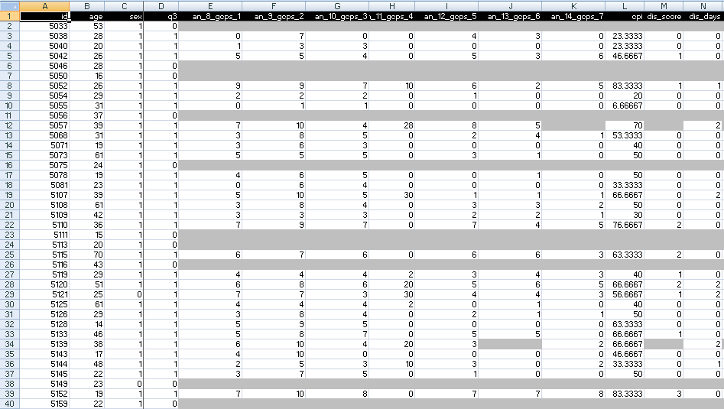
A ‘new style’ approach: a case study
A colleague shares his research data set

Slide 59
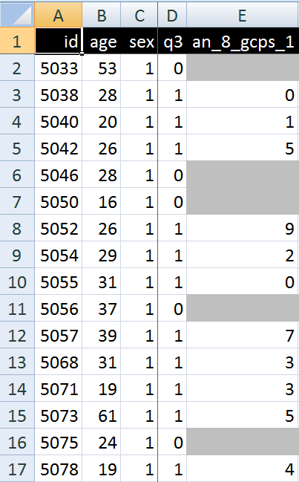
A closer look
What are you going to ask him right away?
What do these various values stand for and how do they relate to each other?

Slide 60
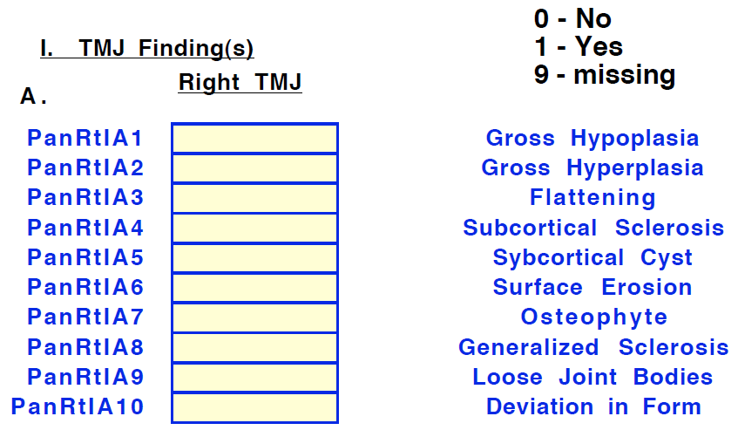
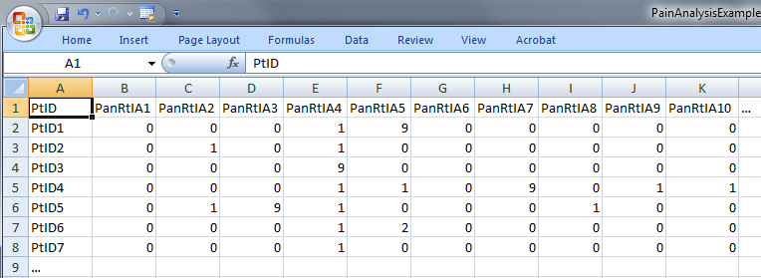
Step 1: ‘meaning’ of values in data collections
‘The patient with patient identifier ‘PtID4’ is stated to have had a panoramic X-ray of the mouth which is interpreted to show subcortical sclerosis of that patient’s condylar head of the right temporomandibular joint’
meaning
1

Slide 61
Step 2 (1): list the entities denoted
1(The patient) with 2(patient identifier ‘PtID4’) 3(is stated) 4(to have had) a 5(panoramic X-ray) of 6(the mouth) which 7(is interpreted) to 8(show) 9(subcortical sclerosis of 10(that patient’s condylar head of the 11(right temporomandibular joint)))’
CLASS | INSTANCE IDENTIFIER
person | IUI-1
patient identifier | IUI-2
assertion | IUI-3
technically investigating | IUI-4
panoramic X-ray | IUI-5
mouth | IUI-6
interpreting | IUI-7
seeing | IUI-8
diagnosis | IUI-9
condylar head of right TMJ | IUI-10
right TMJ | IUI-11
notes: colors have no meaning here, just provide easy reference,
this first list can be different, any such differences being resolved in step 3

Slide 62
Step 2 (2): provide directly referential descriptions
CLASS | INSTANCE IDENTIFIER | DIRECTLY REFERENTIAL DESCRIPTIONS
person | IUI-1 | the person to whom IUI-2 is assigned
patient identifier | IUI-2 | the patient identifier of IUI-1
assertion | IUI-3 | 'the patient with patient identifier PtID4 has had a panoramic X-ray of the mouth which is interpreted to show subcortical sclerosis of that patient’s right temporomandibular joint'
technically investigating | IUI-4 | the technically investigating of IUI-6
panoramic X-ray | IUI-5 | the panoramic X-ray that resulted from IUI-4
mouth | IUI-6 | the mouth of IUI-1
interpreting | IUI-7 | the interpreting of the signs exhibited by IUI-5
seeing | IUI-8 | the seeing of IUI-5 which led to IUI-7
diagnosis | IUI-9 | the diagnosis expressed by means of IUI-3
condylar head of right TMJ | IUI-10 | the condylar head of the right TMJ of IUI-1
right TMJ | IUI-11 | the right TMJ of IUI-1

Slide 63
Step 3: identify further entities that ontologically must exist for each entity under scrutiny to exist.
assigner role | IUI-12 | the assigner role played by the entity while it performed IUI-21
assigning | IUI-21 | the assigning of IUI-2 to IUI-1 by the entity with role IUI-12
asserting | IUI-20 | the asserting of IUI-3 by the entity with asserter role IUI-13
asserter role | IUI-13 | the asserter role played by the entity while it performed IUI-20
investigator role | IUI-14 | the investigator role played by the entity while it performed IUI-4
panoramic X-ray machine | IUI-15 | the panoramic X-ray machine used for performing IUI-4
image bearer | IUI-16 | the image bearer in which IUI-5 is concretized and that participated in IUI-8
interpreter role | IUI-17 | the interpreter role played by the entity while it performed IUI-7
perceptor role | IUI-18 | the perceptor role played by the entity while it performed IUI-8
diagnostic criteria | IUI-19 | the diagnostic criteria used by the entity that performed IUI-7 to come to IUI-9
study subject role | IUI-22 | the study subject role which inheres in IUI-1

Slide 64
Step 4: classify all entities in terms of realism-based ontologies
CLASS | HIGHER CLASS
person | BFO: Object
patient identifier | IAO: Information Content Entity
assertion | IAO: Information Content Entity
technically investigating | OBI: Assay
panoramic X-ray | IAO: Image
mouth | FMA: Mouth
interpreting | MFO: Assessing
seeing | BFO: Process
diagnosis | IAO: Information Content Entity
condylar head of right TMJ | FMA: Right condylar process of mandible
right TMJ | FMA: Right temporomandibular joint
assigner role | BFO: Role
assigning | BFO: Process
study subject role | OBI: Study subject role
requires more ontological and philosophical skills than domain expertise or expertise with Protégé,
not just term matching

Slide 65
Step 5: specify relationships between these entities
For instance:
at least during the taking of the X-ray the study subject role inheres in the patient being investigated:
IUI-23 inheres-in IUI-1 during t1
the patient participates at that time in the investigation
IUI-4 has-participant IUI-1 during t1
These relations need to follow the principles of the Relation Ontology.
Smith B, Ceusters W, Klagges B, Koehler J, Kumar A, Lomax J, Mungall C, Neuhaus F, Rector A, Rosse C. Relations in biomedical ontologies, Genome Biology 2005, 6:R46.

Slide 66
Step 6: outline all possible configurations of such entities for the sentence to be true (a one semester course on its own)
Such outlines are collections of relational expressions of the sort just described,
Variant configurations for the example:
perceptor and interpreter are the same or distinct human beings,
the X-ray machine is unreliable and produced artifacts which the interpreter thought to be signs motivating his diagnosis, while the patient has indeed the disorder specified by the diagnosis (the clinician was lucky)
…

Slide 67
Methodology (2): for each dataset
Build a formal template which describes:
the results of steps 4-6 of the 1st order analysis,
the relationships between:
the 1st order entities and the corresponding data items in the data set,
data items themselves.
Build a prototype able to generate on the basis of the template for each subject (patient) in the dataset an RT-compatible representation of his 1st and 2nd order entities.

Slide 68
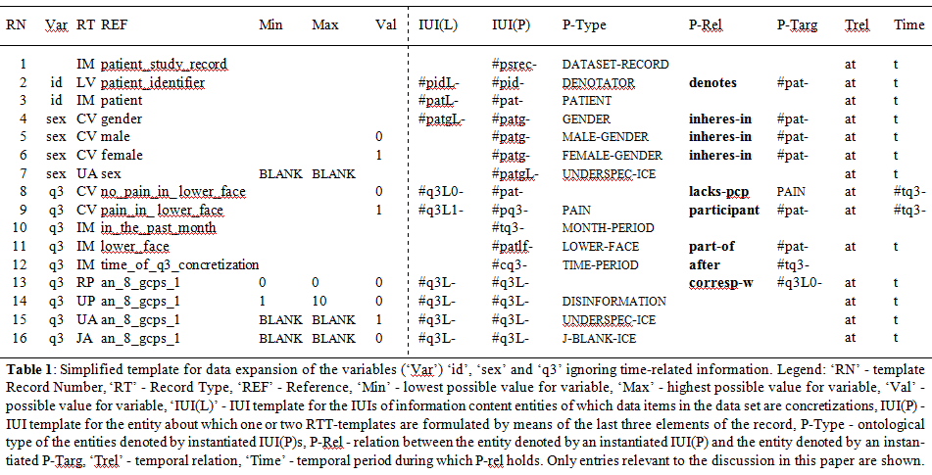
The template

Slide 69
Too difficult ?
you betcha!
But if interested:
700 Course in Referent Tracking

Slide 70
Types of Data Collection in QRM
Survey
Interviews
Focus groups
Observation
(Data) extraction
Secondary data sources
Ethnography
Data collected for different purposes
Secondary use
MC. Harrell & MA. Bradley. Data Collection Methods: Semi-Structured Interviews and Focus Groups. RAND Corporation 2009. http://www.rand.org/pubs/technical_reports/TR718.html

Slide 71
Types of Data Collection in QRM
Survey
Interviews
Focus groups
Observation
(Data) extraction
Secondary data sources
Ethnography
Understandings of culture through representation of 'insider's point of view.’
Participating observation.
MC. Harrell & MA. Bradley. Data Collection Methods: Semi-Structured Interviews and Focus Groups. RAND Corporation 2009. http://www.rand.org/pubs/technical_reports/TR718.html

Slide 72
More on Ethnography
A Simple Introduction to the Practice of Ethnography and Guide to Ethnographic Fieldnotes
Brian A Hoey, Marshall University
http://works.bepress.com/brian_hoey/12/

Slide 73
Kirsti Malterud. Theory and interpretation in qualitative studies from general practice: Why and how? Scandinavian Journal of Public Health, 2016; 44: 120–129
Discussion

Slide 74
Purpose of discussion
Assess:
students pre-reading of the text,
Ability to apply what was learned in the previous section.
Identify gaps in knowledge.
Make sure gaps are covered in the post-lecture test.

Slide 75
1. Complete
I have become increasingly concerned about
…
among qualitative researchers in general practice.
the limited attention to theoretical perspectives

Slide 76
2. Explain
This diversity
[in the way journals deal with qualitative research papers which are scientifically badly constructed]
reflects contemporary disparities and praxises
between researchers, research traditions and academic
disciplines, indicating that a universally
approved theoretical standpoint does not exist.

Slide 77
3. Complete
The dominant view of theory within biomedicine is
…
an accumulated mass of knowledge as a correct representation
of reality

Slide 78
4. Complete
A […] is a consistent and soundly based set of
assumptions about a specific aspect of the world, predicting
or explaining a phenomenon.
A […] is a simplified representation or image of a theory.
Options: ‘theory’ ‘model’

Slide 79
5. Discuss
A theory is a consistent and soundly based set of
assumptions about a specific aspect of the world, predicting
or explaining a phenomenon.
A model is a simplified representation or image of a theory.

Slide 80
6. What is the essence of a positivist viewpoint?
A positivist viewpoint implicates a dichotomy between
(1) objective, empirically verifiable knowledge
and
(2) subjective, unverifiable knowledge,
leading to
(a) a corresponding distinction between
(a1) fact and (a2) value,
and
(b) the idea of a value-neutral science

Slide 81
7. Malterud’s view on Positivism and Medicine?
Medicine is strongly influenced by positivism,
assuming a stable ontology where the world is subject
to fundamental and unchanging rules [19].
Phenomena such as diseases are considered as
observable, steady and true entities over time, with
epistemological assumptions of universal, objective
facts to be identified and predicted by standardized,
deductive approaches and research methods where
controlled observations yield objective certainty.

Slide 82
8. ‘Methodology’ versus ‘methods’
Methodology:
the description and analysis of principles shared by a family of research methods.
Methods:
refer to specific procedures intended to operationalize the methodology in different contexts.

Slide 83
9. Good news? Fill in …
Comprehensive philosophical expertise is not required
to handle qualitative methodology in a responsible
way, unless …
the project claims specific commitment to
a particular philosophical perspective.

Slide 84
10. Three styles of code-book creation
Depending on to the role of theoretical commitment regarding the categorization of data:
Template analysis style: is a theory-driven analysis where coding categories are predetermined from existing taxonomy or theories,
Immersion/crystallization style: develops categories from scratch with the empirical data as the foundation.
Editing analysis style: something in between.

Slide 85
11. Deductive or inductive?
A deductive approach proceeds from:
a general rule and asserts that this rule explains a single case.
An inductive approach proceeds from:
single cases, assuming that a connection between them may also be generally valid.
A qualitative study typically takes an:
inductive, open-ended approach, where the development of patterns and categories is an important element of the final results.

Slide 86
12. Malterud critiques poorness in QR reporting. Most common mishaps?
Omitting theory at all.
Name dropping: referring to certain QR paradigms but actually work has nothing to do with them.
Gap between theoretical claims and analytical practice.

Slide 87
13. Dangers of too much theory
Methodolatry:
a combination of method and idolatry, to describe a preoccupation with selecting and defending methods to the exclusion of the actual substance of the story being told.
the slavish attachment and devotion to method that so often overtakes the discourse in the education and human services field.
Methodological fundamentalism:
insistence that a particular methodology is somehow the ‘one true’ qualitative research and should never be changed or combined with elements of other methodologies.

